Slide 1


LEADERSHIP IMPACT
Two-day workshops to improve an
individual’s leadership strengths, styles and capability
1

Slide 2
Index
Title | Page Number
Your Need As We Understand | 3
Our Approach | 4 - 6
Tentative Vital Leader Journey | 7
Sample Learning Objectives | 8
Breadth of Perspectives | 9 - 12
Understanding Others | 13 – 16
Adaptability | 17 - 20
Team Leadership | 21 - 24
Sustaining the Change | Progress IT | 25
Sustaining the Change | Coaching Calls | 26
Sustaining the Change | Fruit Calls | 27
Room Layout & Things Required | 28 - 29
Discover | 30
Commercial Investments | 31 - 34
Terms and Conditions | 35
Next Steps | 36
2

Slide 3
Your Need As We Understand
Background
JSW, A $11 billion conglomerate, with presence across India, USA, South America & Africa, the JSW Group is a part of the O.P. Jindal Group with strong footprints across core economic sectors, namely, Steel, Energy, Infrastructure, Cement, Ventures and Sports. Conducting every aspect of the business responsibly and sustainably is the core value of this organization. It also believes and works towards developing its people.
The target audience is a group of 276 managers, senior managers, assistant general mangers and deputy general managers. In the first phase of their assessment , i.e. in the Manager and Reviewer Assessment, they were not identified as high potential by their manager / reviewer, based on their scores. Therefore, they couldn’t be taken to the next Case Study level of assessment. This team seems to be confronted with areas of development based on the following competencies:
Breadth of Perspectives
Understanding Others
Adaptability
Team Leadership
Opportunity
This program is a proactive measure to bridge gaps in the above mentioned competencies so as to improve the management pipeline of the organization. Post this intervention, the leaders envision these managers to experience, learn and walk on the path of self excellence.
Implication
JSW wants Maynard Leigh to facilitate a leadership journey for these managers to support them in this path of tranformation into vital leaders. The journey should focus on 4 competencies: Breadth of Perspectives, Understanding
Need
Others, Adaptability & Team Leadership.
3

Slide 4
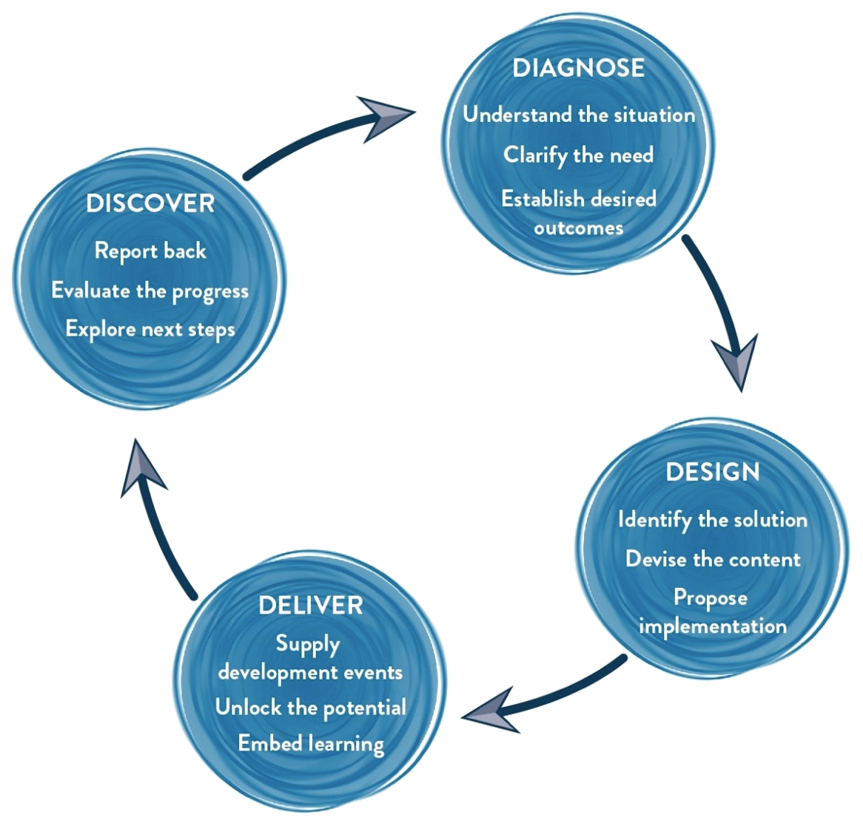
Our Approach
Methodology
We use interactive theatrical exercises along with Psychological and L & D tools.
4

Slide 5

Our Approach | Design
Design Customization: The consultant will design the final objectives and customize the content of the learning intervention. Modules of the workshops are designed, activities are mapped to the group’s needs, new handouts are drafted based on the content.
Diagnosis report: A report is generated which would reflect our understanding of the competency parameters
6

Slide 6
Proposed Leadership Impact Journey
WORKSHOP 1
WORKSHOP 2
Fruit Call
We will begin the journey by looking at our own selves & patterns of excellence towards a world of change
Which is why the 1st workshop will begin by looking at ADAPTABILITY
By day 2 of the first workshop the focus will shift from the self towards how to apply personal patterns of resilience & adaptability to the larger picture
This is when we will address BREADTH OF PERSPECTIVES
Thse second leg of our journey comprises of how we inspire excellence in others through →
A) UNDERSTDANDING OTHERS and B) Applying this backbone of understanding to TEAM LEADERSHIP
STRATEGIC EXCELLENCE
EXCELLENCE THROUGH OTHERS
SELF EXCELLENCE
ME
WE

Slide 7



Learning Objectives | Through attending this event, participants will:
Breadth of Perspective Positive Indicator Demonstrates openness to learn new ideas, skills and concepts. Generates alternate solutions to business issues and champions innovative thinking Does not hesitate to question status-quo or traditional approaches Appreciates and leverages diverse ideas, cultures and thinking. Demonstrates a sound understanding of different business drivers and their impact on own role/ team/function. Is quick to spot trends, underlying patterns in issues and identify inter-dependencies across the organization Behaviors Across Proﬁciency Levels Encourages teams to think differently, identify alternate solutions and to change inefficient work practices Questions current processes and existing approaches when generating solutions to resolve business issues. Demonstrates sensitivity to diverse cultures, mindsets and ideas as well. Demonstrates an understanding of the business environment and its impact on own and team's contributions. Recognizes inter-linkages in data, conducts root- cause analysis to establish patterns and anticipate future issues | Understanding Others Positive Indicator Understands impact of own interpersonal style on others. Demonstrates sensitivity to challenges, motives and objectives of others. Builds strong relationships across internal and external stakeholder groups. Integrates views of others to create collective/ win-win solutions and foster collaboration. Demonstrates credibility and tact in handling interpersonal conflicts. Behaviors Across Proﬁciency Levels Tailors own interpersonal style when interacting with stakeholders within and outside of own team/function. Demonstrates a sound appreciation of challenges, perspectives and motives of different stakeholders when engaging with them. Relates well to people across levels and builds fruitful relationships with stakeholders. Drives collaboration and win-win solutions within and outside own teams. Works to diffuse conflicting environments amongst teams by demonstrating resilience, tact and understanding of behavioral needs of others. | Adaptability Positive Indicator Demonstrates a positive outlook towards new ideas and flexibility to adapt to changes. Anticipates changing demands of the environment to modify own approach accordingly . Navigates ambiguous and uncertain environments making positive use of the opportunities it presents. Behaviors Across Proﬁciency Levels Encourages teams to adopt a positive outlook towards changing environments and identifies opportunities for improvement. Enables teams to anticipate changes in the environment and builds flexible teams. Is able to anticipate possible future course of action aligned to the changing needs of the customer | Team Leadership Positive Indicator Provides necessary support, guidance to teams to navigate roadblocks and focus on organizational goals. Understands strengths and underlying learning needs of team members. Encourages dialogue to ensure surfacing of issues in an open and constructive manner. Receptive to team dynamics. Motivates and empowers teams with necessary authority to take decisions. Recognizes contributions of others and provides development opportunities Behaviors Across Proﬁciency Levels Understands concerns and roadblocks faced by own team in achieving deliverables and provides necessary guidance and support . Understands the strengths and gaps in skill levels of team members to effectively identify learning needs. Creates an open environment amongst team members and encourages transparency in sharing issues. Invests trust in team members and allocates accountability and autonomy for them to take decisions. Proactively recognizes high performance behaviors, outcomes amongst team members and institutes relevant development support. 8

Slide 8
WORKSHOP 1 THE ADAPTABLE LEADER WHO OFFERS A BREADTH OF PERSPECTIVES
17

Slide 9



Learning Objectives | Through attending this event, participants will:
Think:
It’s imperative to demonstrate a positive outlook towards new ideas and flexibility to adapt to changes
A problem solving mind set is necessary to be able to navigate the current business reality
I am going to navigate ambiguous and uncertain environments making positive use of the opportunities it presents
I need to be more open to learn new ideas, skills and concepts
I am capable of generating alternate solutions to business issues
I am going to work towards becoming a champion of innovative thinking
My job entails to question status-quo or traditional approaches
Feel:
Confident about my ability to adapt to change
Committed to take action to sustain the change
Comfortable to learn at all times
Appreciative about diverse ideas, cultures and thinking
Excited about the challenge of producing new ideas &tackling problems
Be more able to:
Examine problems in a unique and unusual way
Solve difficult problems by applying innovative thinking
Encourage teams to think differently, identify alternate solutions and to change inefficient work practices
Demonstrate sensitivity to diverse cultures, mindsets and ideas as well
Take initiative in the workplace

Slide 10
Design | Day 1 (18 participants per batch per consultant)
Narrative | Session | Session Details | Methodology
Becoming ready to engage with oneself and be more present to the space | Warm up Intro & context | Warming up – mind, body, breath Becoming present to the space and to each other VUCA MODEL & Frog story or Plato’s Cave story | Theatre based activity Storytelling
An experience that puts participants in the middle of change and has them respond to it in the moment | The Neutral Bench | A simulation where the situation and the nature of change is handed to you by an external agency Changes come constantly and are of an unpredictable nature | Improv Theatre
To be more aware of inner dialogues around change | Internal Dialogues | Become aware of the internal dialogues that take place when one is faced with stimulus to change Becoming aware of the difference between victim and chooser attitudes to change | Role based coaching
Identifying entry points to how we create change. Starting conversations around the emotions around change and what leads us to change | Personal Stories | Sharing with the larger group around the following: One change you resisted / did not make One change you became aware you had to make and were able to create | Narrative Coaching
How can I recognize when I am letting stress and fear hinder my problem solving? What can I do about it? | Victim & Chooser | More likely to be a victim rather than a chooser in the changing scenario. Take initiative in my area of work to avoid drops | Improv Theatre
Participants get to share with the group their unique individual challenge | Roadblocks Presentation | Participants will share the objects that represent their roadblocks to change / adaptability | Physicalisation of problem statement
Closing the day with action points on “what I will do” | The road to roadblock removal | Presenting group theatre performances on actions one needs to take to overcome their roadblocks to change and being more adaptable | Culminating performances

Slide 11
Design | Day 2 (18 participants per batch per consultant)
Narrative | Session | Session Details | Methodology
We begin the day with an energizer and a creative recap | Warm up Creative recap | Becoming present to the space and to each other | Theatre based exercise
Right in the begin, we open our eyes to the future…what can we anticipate, what do we desire? | Visioning Exercise | Aligning to my own vision for the future | Art based activity
Often leaders get caught up in the everyday…how do we deal with this “everyday”? Can we do it more creatively & strategically? | Card Game | A high energy game that involves creative group process | Game based learning
An understanding of innovating thinking | Introduction to creative processes | Stages of Creative Process: Challenge, Preparation, Frustration, Incubation, Aha!, Elaboration, Implementation
This is really about taking initiatives and helping the entire team shine together | Creative Collaboration | An introduction to the principles of collaboration in order to open myself up to new ideas being thrown at me as well as encouraging those around me to shine | Improv Theatre
It is time to reconnect with our vision, relook at our patterns that might be stopping us from bringing this strategic vision alive | Motivation for Peak Performance | Connecting back to our vision, our larger, more strategic purpose as leaders | L & D model inspired by sports psychology
Recognize my own biases / limitations in perspectives | Sherlock | An activity that encourages one to acknowledge their limited perspective. This is an exercise in widening one’s lens | Theatre based activity
Recognizing that I am not “one story” and neither is anyone else | Cuts Story | Looking at one’s own limited view of oneself. Breath of perspective begins to involve my expanded view of myself and of others | Philosophical backbone
Discovering our own inner potential and seeing what we need to expand in ourselves in order to widen our horizons | Inner Cast of characters | Connecting back once more to my strategic vision & relooking at the characters I have been playing. What do I need to be more of and what do I need to be less of? | Psychodrama
Closing the day on a note of making commitments to ourselves that we promise to live by | CAN-I and commitment videos | Sharing the model of constant & never ending improvement and tying the learning from both days up by committing to individual action | Anchoring learnings

Slide 12
WORKSHOP 2 THE UNDERSTANDING LEADER WHO CAN FLEX THEIR STYLE TO OFFER WHOLESOME LEADERSHIP TO THEIR TEAMS
13

Slide 13
Sample Learning Objectives | Through attending this event, participants will:
Think:
I understand impact of my own interpersonal style on others
I can demonstrate sensitivity to challenges, motives and objectives of others.
I can build strong relationships across internal and external stakeholder groups
I should strive to integrate views of others to create collective/win-win solutions and foster collaboration
I am going to provide necessary support, guidance to teams to navigate roadblocks and focus on organizational goals
Its important to recognize contributions of others and provides development opportunities
I must motivate and empower teams with necessary authority to take decisions
Be more able to:
Tailor my own interpersonal style when interacting with stakeholders within and outside of own team/ function.
Demonstrates a sound appreciation of challenges, perspectives and motives of different stakeholders when engaging with them.
Relate well to people across levels and build fruitful relationships with stakeholders.
Drive collaboration and win-win solutions within and outside own teams.
Work to diffuse conflicting environments amongst teams by demonstrating resilience, tact and understanding of behavioral needs of others.
Encourage dialogue to ensure surfacing of issues in an open and constructive manner.
Understands the strengths and gaps in skill levels of team members to effectively identify learning needs
Invests trust in team members and allocates accountability and autonomy for them to take decisions
Feel:
Confident to lead self and others
Receptive to team dynamics
Aligned with others
Committed to develop the team
Be sensitive to the challenges & motivations of others
Feel connected to my team

Slide 14



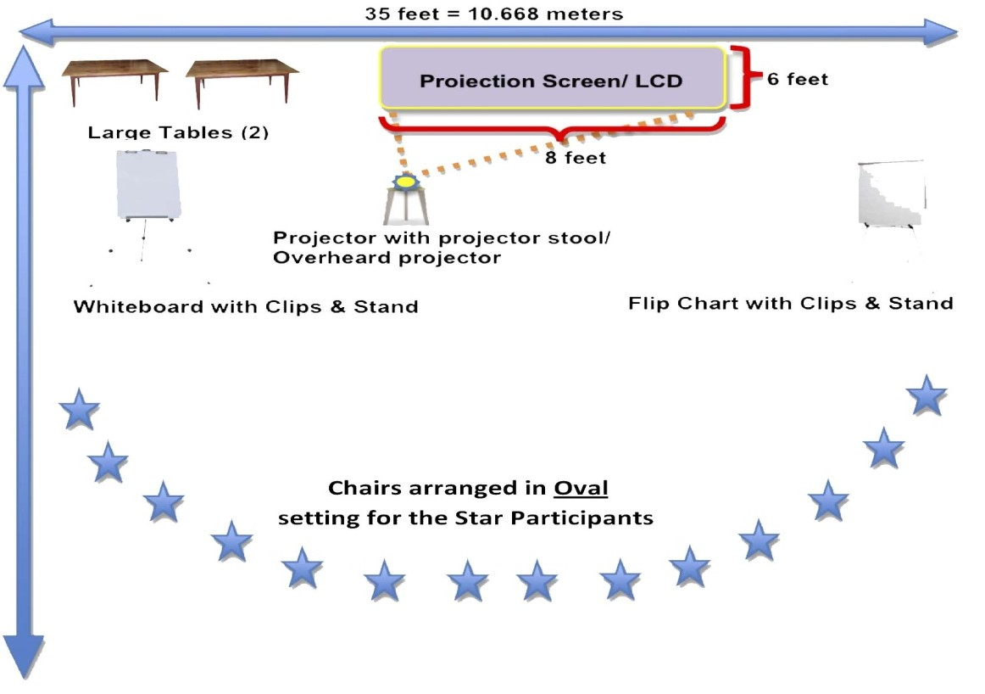
Room Layout
We love alternative ways of setting up a workshop! Creating an atmosphere where the participants feels absolutely comfortable and yet challenged. In this workshop, the use of theatre, team games and experiential methodologies are essential ingredients, hence we’d require ample place to move around and make noise.
Please book a space with ample natural light (Yes, we want sunlight streaming in) and no fixed furniture for the participants to work with one Maynard Leigh consultant.
28

Slide 15


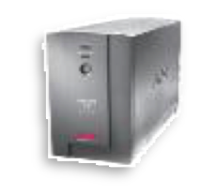

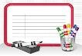
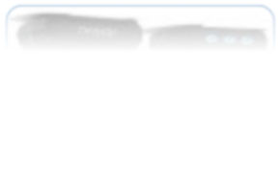

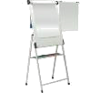


Things Required at the Venue
For the workshop, we will need the below mentioned:
LCD projector and projection screen
UPS Power Back-up for Laptop, LCD projector & Laptop speakers
External speakers (for laptop connectivity). The external speakers should be loud enough to play music for the team.
White board & White board markers (2 blue, 2 black, 2 green)
Flip chart and Flip chart stand with suitable clips
Colour pens (Normal sketch pens - about 40)
Notepads and pens (for participants)
Blu Tac (This substance is used to stick things, posters or paper on the wall)
30 A4 Size normal and drawing sheets
2 tables for the consultant( one will be used for the projector and the other for keeping the handouts)
29

Slide 16

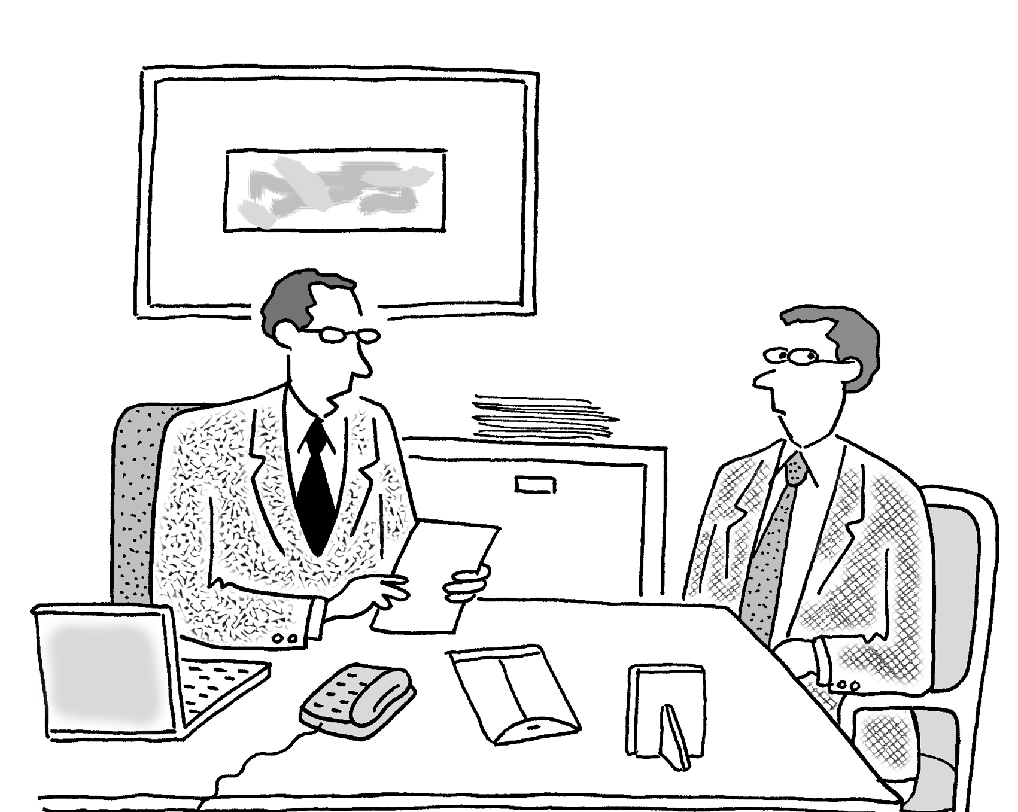
Discover
A one to one meeting with HR stakeholders to take feedback on the intervention and how it was received and next action steps.
30

Slide 17
Your Investment: Workshop 1
Diagnose & Design – ONE TIME COST
Half – day customizing the design | INR 46,000/-
Delivery (for 20 participants per batch)*
Activity | Investment
Professional fee for delivery | INR 75,000 per consultant per day X 1 consultant X 2 days To be printed by JSW | INR 1,50,000/-
Learning material (handouts) |  | -
Total Investment for journey covering 15 participants ( 1 batch)** |  | INR 1,50,000/- **
Total investment per participant** |  | INR 7,500/- **
*In case of more than 20 participants, 2 Maynard Leigh consultants will be3n1 eeded.
**Total investment doesn’t include the Diagnosis & Design one time cost.

Slide 18
Your Investment: Workshop 2
Diagnose & Design – ONE TIME COST
Half – day customizing the design | INR 46,000/-
Delivery (for 20 participants per batch)*
Activity | Investment
Professional fee for delivery | INR 75,000 per consultant per day X 1 consultant X 2 days To be printed by JSW | INR 1,50,000/-
Learning material (handouts) |  | -
Total Investment for journey covering 15 participants ( 1 batch)** |  | INR 1,50,000/- **
Total investment per participant** |  | INR 7,500/- **
*In case of more than 20 participants, 2 Maynard Leigh consultants will be3n1 eeded.
**Total investment doesn’t include the Diagnosis & Design one time cost.

Slide 19
Commercial Terms & Conditions
v Client is responsible for providing venue, conference facilities, AV equipment.
v Travel outside Delhi NCR - Air, stay & airport/ venue cab transfers to be taken care by the client.
v Travel inside Delhi NCR - at Rs. 12.00 Per Km.
v Not inclusive of applicable taxes (GST@ 18%)
v A commercial contract will be signed before the execution of the project.
v 50% of cancellation fee will be charged on any cancellation or postponements that occur within 20 working days of the confirmed date of delivery.
v 100% of cancellation fee will be charged on any cancellation or postponements that occur within 0 to 2 working days of the confirmed date of delivery.
v The above commercials are valid till the 31st March, 2018
v Contracts, legal & accounting paperwork (including billing & payments) will be in the name of “Life Strategies Humancare Pvt. Ltd.”
35

Slide 20

Next Steps
Vendor Empanelment: Since we are working with you for the first time, let us initiate vendor empanelment at the earliest.
Contracting and PO: Once we close on the vendor empanelment, let us close on the contract
and PO.
Diagnose - We’d like to begin the diagnosis phase to clarify the need and establish the learning outcomes.
Book: Let us block the dates for the Diagnosis and Design right away so that we have
consultants available for you.
36

Slide 21

Let’s work in partnership to create impact & unlock potential
For further information please connect with:
Contact Revati Sahijwani / Vivek Arora
Email revati@maynardleigh.in / vivek@maynardleigh.in Telephone +91 9650043817 / +91 9810811385
37

